Slide 1


Bankruptcy Prediction
Python for Data Analysis Project
Anne Tran

Slide 2
Bankruptcy prediction is the art of predicting bankruptcy and various measures of financial distress of public firms. It is a vast area of finance and accounting research. The importance of the area is due in part to the relevance for creditors and investors in evaluating the likelihood that a firm may go bankrupt.
It plays a great role in economic decision making. Bankruptcy prediction can help companies understand their situation better and help them figure out how long then can last in the present scenario. They can use the reports to attract investors and get loans.
CONTEXT OF STUDY

Slide 3
About the dataset
The Polish companies dataset we are using in this project is from the UCI website.
This project’s aim is to find the best model to predict which companies will go bankrupt based on the 64 financial attributes of the dataset. This is a classification problem.
The 5 arff files given included 10,503 examples. The data was collected from Emerging Markets Information Service, which is a database containing information on emerging markets around the world. The bankrupt companies were analyzed in the period 2000-2012, while the still operating companies were evaluated from 2007 to 2013. Each file corresponds to a year of observations.

Slide 4
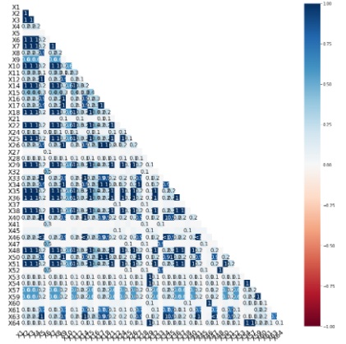
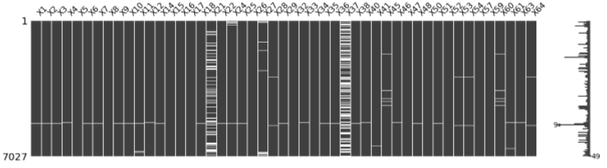
Data exploration
The source of the dataset stated that there were many missing values.
In this first part of the project, we focused on how to deal with the missing data.
The sparsity matrix for the year1 dataset
Heatmap for year1

Slide 5
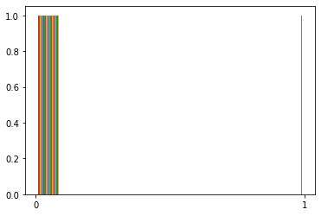
The sparsity matrix for all 5 years showed that a lot of data is missing from column X37. Overall, all attributes of the dataset have some missing data, we shouldn't delete all the rows with missing values, as it can cause severe data loss for our dataset. The dataset is quite imbalanced and sparse.
The heatmap shows that no features are distinguishably correlated to another in all dataframes therefore we can't remove any features. We need to fill in the gaps to deal with the missing data. We used Mean imputation to do do.
Taking a look at our class label Y, we saw that the dataset is very imbalanced. There is a large amount of data/observations for one class and much fewer observations for one or more other classes. If we leave the dataset as it is, we won't be able train our models well.
We used SMOTE (Synthetic Minority Over Sampling Technique) function from the imblearn library to balance out the dataset and oversample the minority class.

Slide 6
Data modeling
Models we tried to predict bankruptcy :
Naive Bayes
Logistic Regression
Gradient Boosting Tree
Decision Tree Classifier
Random Forest
We used the following to evaluate the performances of each model :
Accuracy score
Recall Score
Precision Score

Slide 7
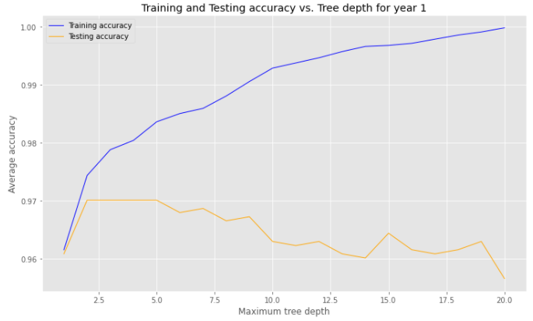
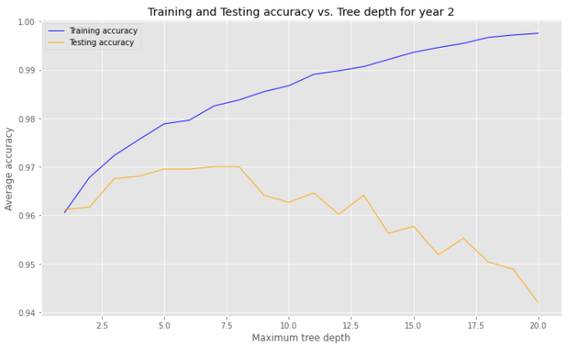
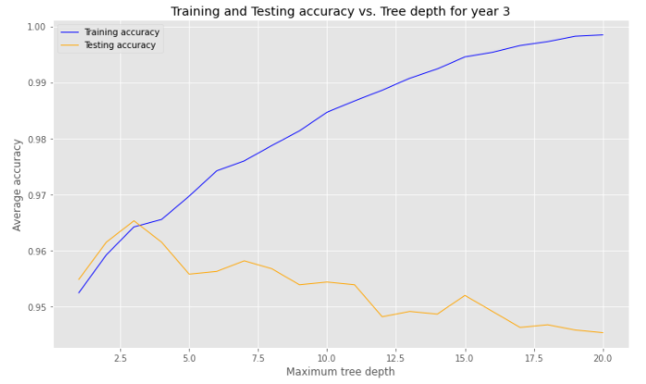
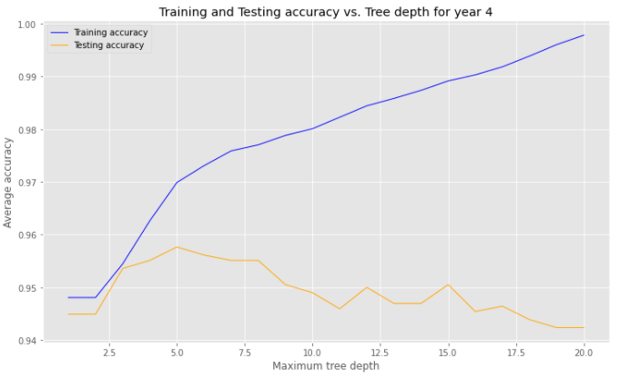
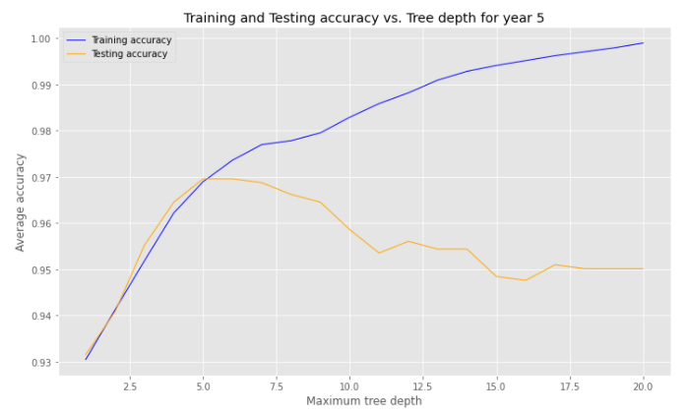
Decision Tree Classifier

Slide 8
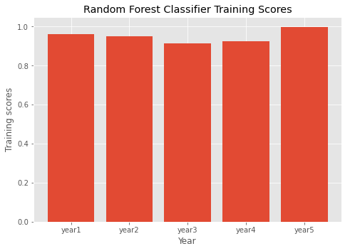
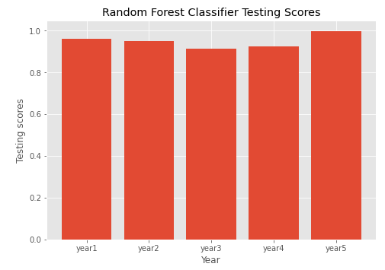
We used a cross validation method to find the best depth for our Decision Tree classifier and we obtained the highest accuracy score for depth n=5 overall.

Slide 9
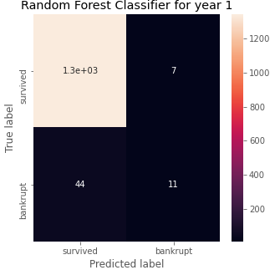
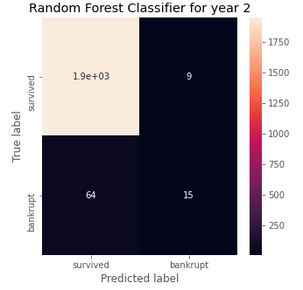
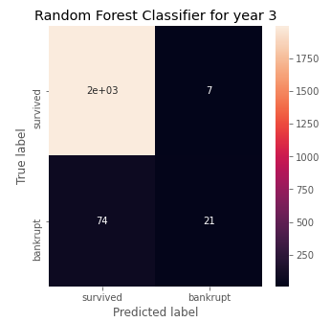
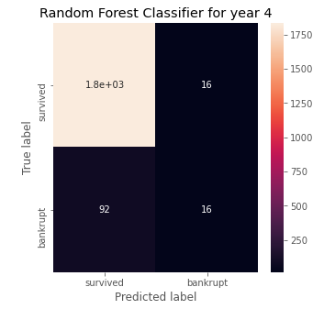
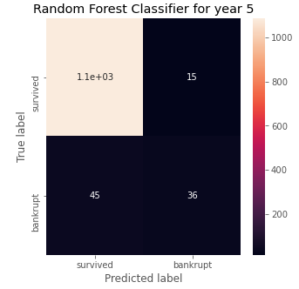
Random Forest
Our confusion matrix for this model shows great results just as Decision Tree. Tree based models seems to work the best for our problem here, because they perform well with data that has many categorical variables. Random forest used several Decision Trees to predict the class label.

Slide 10
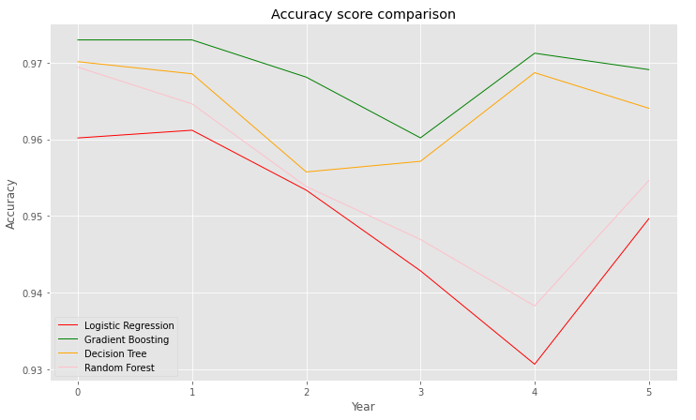
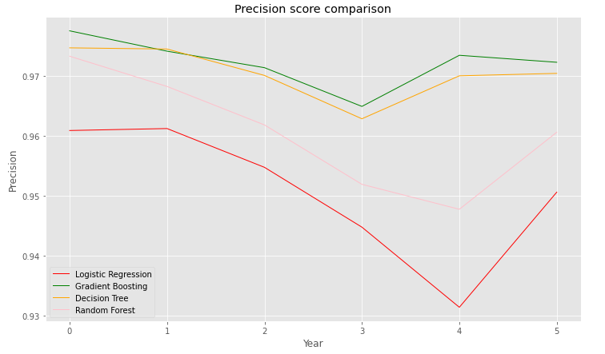
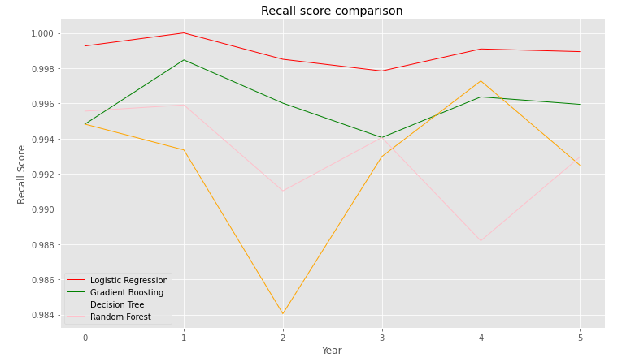
Evaluating our models

Slide 11
Conclusion
Gradient Boosting model (3rd position in our list firstmodel) has the highest accuracy and precision scores and the 2nd best recall rate behind the Logistic Regression model. Gradient Boosting model is therefore the best model for predicting bankruptcy among those we have tested. Logistic Regression and Decision Tree come as close second. Naïve Bayes performed the worst among all the models we tested.
We could also try looking at which variables are the most correlated to bankruptcy, and recommend them to banks. More imputation techniques such as K-nn could have been used and could have improved the model accuracy further.

